Slide 1
Vacation Activities Research
Initial Survey Results for
Prepared by Amy M. Gregory
March 24, 2019

Slide 2
Survey Details
Study Objectives
  Identify preferences and motivation by activity type
Survey
  Launched March 3rd
  294 completed surveys

Slide 3
Participants
Gender
  61% female
Average age = 44
  60s – 70s = 14%
  40s – 50s = 44%
  20s – 30s = 39%
Travel Party Composition
  4.52 travelers (average) in party
  Travelling with spouse/partner, children, parents, friends

Slide 4
Highlights
Guests are very satisfied with their vacation and the current activities offered.
Five (5) activity types emerged as dominant.
Three (3) motivations prevailed.
*Finding is not statistically significant

Slide 5
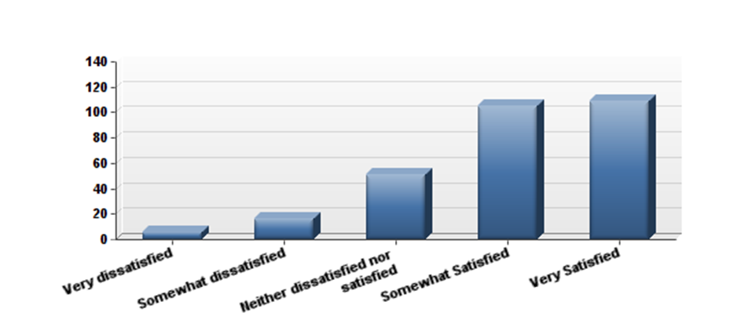
Overall satisfaction with current activities

Slide 6
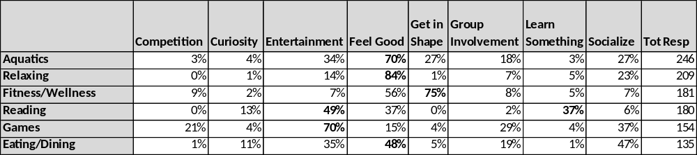
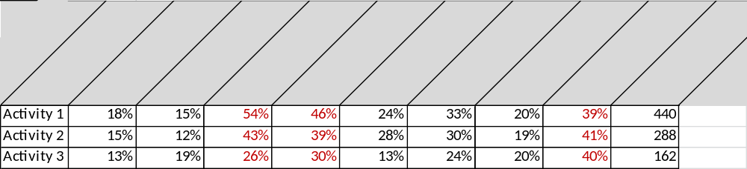
Please help us understand what it is about this activity that entices you to do it.

Slide 7
Thank you!
Amy.Gregory@UCF.edu

